Slide 1
Unit 4 Energy & Power
Part D: Energy Conversion and Perfect Conductor
Notes:
Hi! Welcome to Unit 3: Resistance and Ohm’s Law, Part A on Resistance.

Slide 2
What will we learn?
How electrical energy is converted to heat in a resistive material.
The lost in electrical energy results in voltage drop across a resistive material.
Know the characteristics of perfect conductor.

Slide 3
Heat Dissipation and Voltage Drop
When the electron current passes through a resistive material, such as a resistor,
the free electrons collide with ions in the resistive material,
the free electrons are scattered in random motion and do not move in the well-aligned manner as inside a conductor.
This causes conversion of electrical energy to heat energy.
The lost of electrical energy results in a voltage drop across the resistive material.
+
_
V

Slide 4

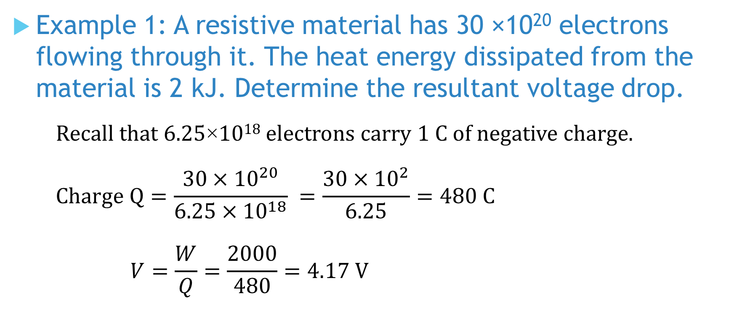
Example 1: A resistive material has 30 ×10²⁰ electrons flowing through it. The heat energy dissipated from the material is 2 kJ. Determine the resultant voltage drop.
Recall that 6.25×10¹⁸ electrons carry 1 C of negative charge.
$$Charge Q=\frac{30×{10}^{20}}{6.25×{10}^{18}} =\frac{30×{10}^{2}}{6.25}=480 C$$
$$V=\frac{W}{Q}=\frac{2000}{480}=4.17 V$$
Notes:
You have a camera sitting beside you. Its screen view indicates a low battery. You retract it and notice a label on it reads: 3.7 V, 1000 mAh; Minimum 940 mAh or 3.5 Wh.
Another big question for you.

Slide 5
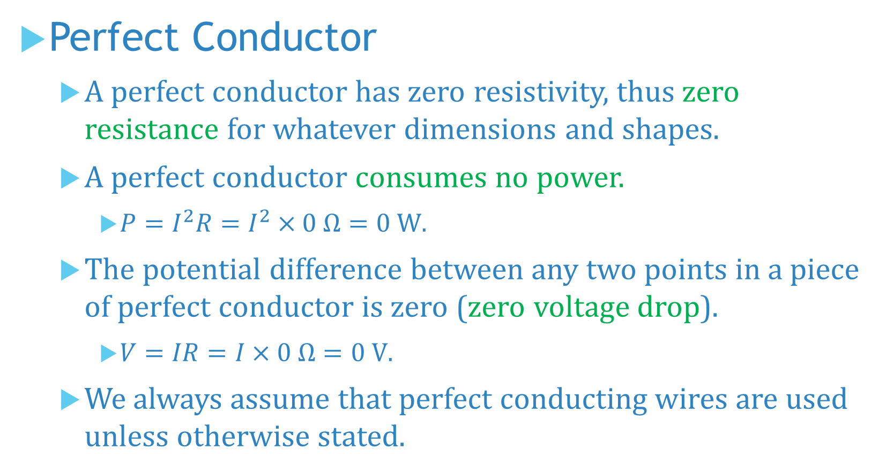
Perfect Conductor
A perfect conductor has zero resistivity, thus zero resistance for whatever dimensions and shapes.
A perfect conductor consumes no power.
$P=I^{2}R=I^{2}×0 Ω=0 W$.
The potential difference between any two points in a piece of perfect conductor is zero (zero voltage drop).
$V=IR=I×0 Ω=0 V$.
We always assume that perfect conducting wires are used unless otherwise stated.

Slide 6
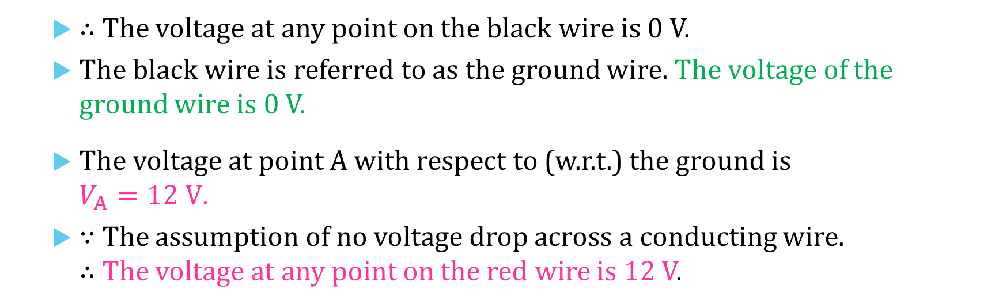
B
C
Perfect Conductor
The voltage at the reference ground is 0 V.
∵ The potential difference between any two points in a piece of perfect conductor is zero.
A
I
+
_
D
12 V
R
E
G
F
∴ The voltage at any point on the black wire is 0 V.
The black wire is referred to as the ground wire. The voltage of the ground wire is 0 V.
The voltage at point A with respect to (w.r.t.) the ground is $V_{A}=12 V$.
∵ The assumption of no voltage drop across a conducting wire. ∴ The voltage at any point on the red wire is 12 V.

Slide 7
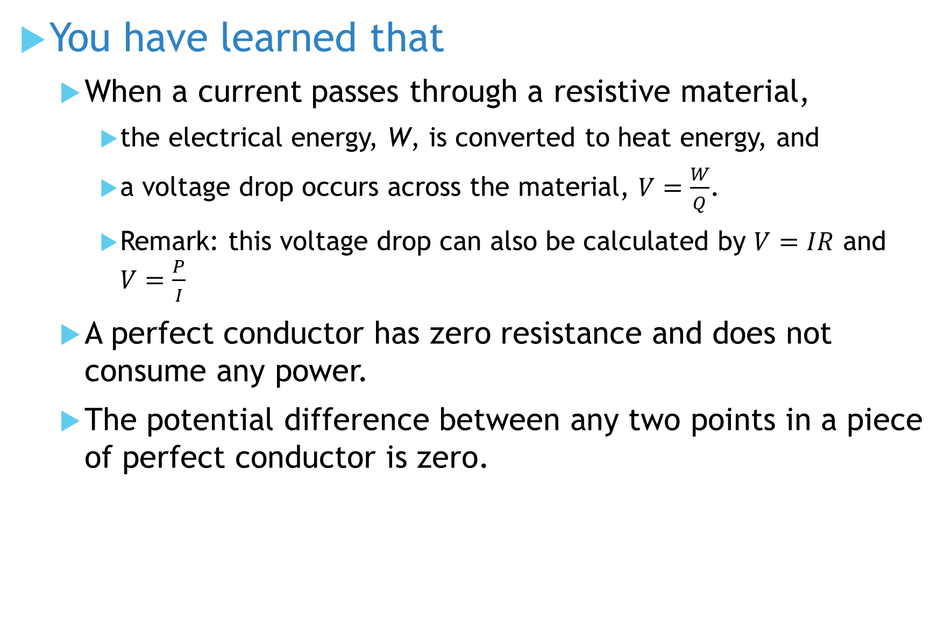
You have learned that
When a current passes through a resistive material,
the electrical energy, W, is converted to heat energy, and
a voltage drop occurs across the material, $V=\frac{W}{Q}$.
Remark: this voltage drop can also be calculated by $V=IR$ and $V=\frac{P}{I}$
A perfect conductor has zero resistance and does not consume any power.
The potential difference between any two points in a piece of perfect conductor is zero.

Slide 8
Coming Up Next
Unit 5, Series Circuits

